Slide 1
ThermalBracelet : Exploring Thermal Haptic Feedback Around the Wrist
Peiris, R.L., Feng, Y-L., Chan, L. & Minamizawa, K. (2019)

Slide 2
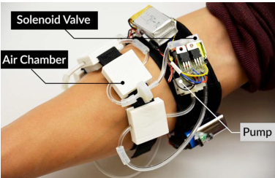
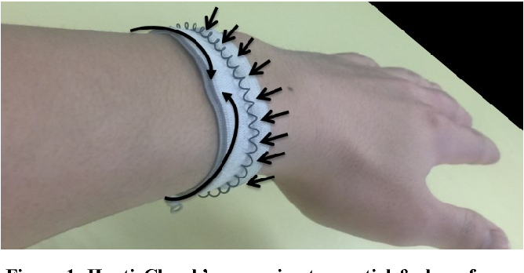
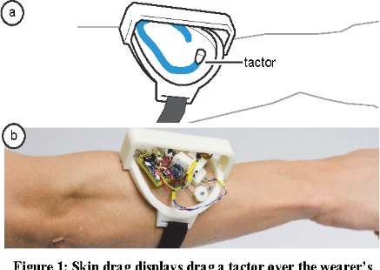
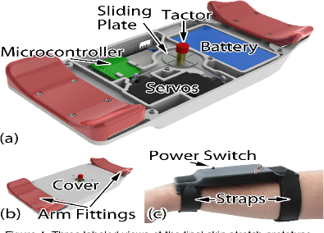
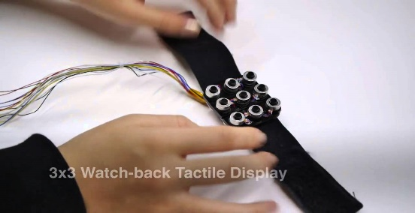
Introduction
Wrist-worn smart devices is a widely explored area for haptic feedback
Variety of haptic feedback
This paper explores perception characteristics of “thermal” haptic feedback around the wrist
Pressure
Clenching
Dragging
Skin stretching
Wind

Slide 3
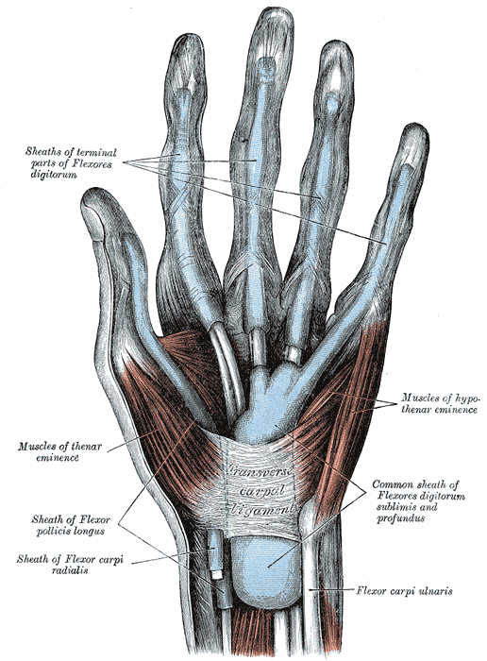
Thermal Haptic Feedback
Thenar eminence and the wrist are sensitive regions for thermal cues
A lot of research has gone into thermal feedback in the thenar eminence
More recent research has gone into the wrist to
Explore expressivity
Communicate weather information (RainSense)

Slide 4
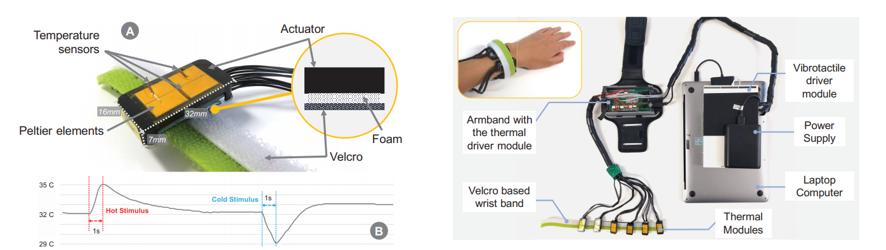
Selection of Thermal Modules
Peltier elements = thermal actuator
Capable of providing fasts changes in temperature
Includes thermal modules, temperature sensors, and vibrotactile modules

Slide 5
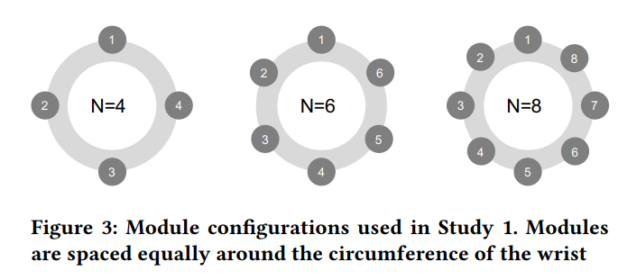
Study 1: Thermal Perception Around the Wrist
Main goal: 1) Perception limit of thermal haptic feedback
2) Select a suitable configuration to provide feedback
Stimuli: ±3°C stimuli for 1 second

Slide 6
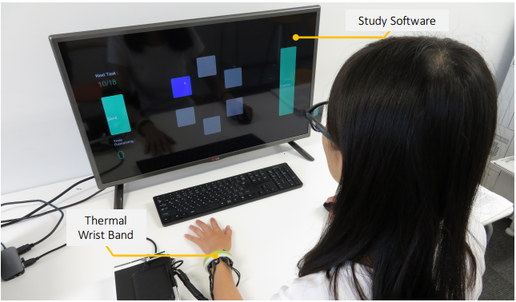
Study 1: Methods
Within-subjects (12 participants)
IV: Configuration (4, 6, 8) & Thermal Level (Hot or Cold)
DV: Accuracy of the perceived location and thermal level
15 second interval to return temperature to starting skin temperature
Select location of perceived stimuli
1 second stimuli
Notes:
Wrist size & skin temperature measured
& room temperature controlled
Thermal adaptation effect

Slide 7
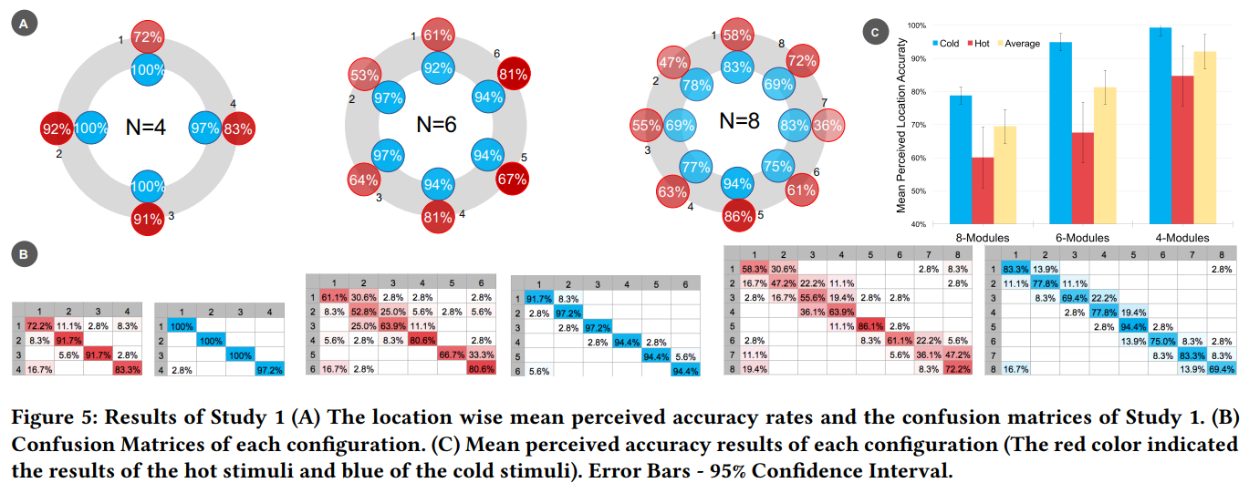
Study 1: Results and discussion
Notes:
Red boxes indicate that the hot stimuli were particularly uncomfortable and thus caused difficulties in perceiving the location accurately. Could be due to the uneven muscles/skin density around the wrist
Skin contains more cold receptors than hot receptors.
Post interview = hot stimuli uncomfortable & cold stimuli were more crisp, sharp, clear.

Slide 8
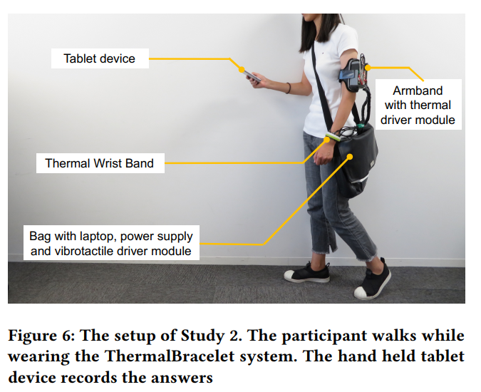
Study 2: Thermal Feedback in a mobile scenario
Semi-realistic scenario: Walking
Thermal vs. Vibrotactile
IV: Feedback Modality
DV: Accuracy of perceived location and stimulus detection time
NASA-TLX questionnaire (Hart & Saveland, 1988) after each condition
Notes:
Walk back and forth and read a text while doing so. Tap on tablet as soon as the stimulation and location was identified.
Tapping = RT.
After tap, remove text and record loation perceived.
The NASA Task Load Index (NASA-TLX) is a widely used,^{[1]} subjective, multidimensional assessment tool that rates perceived workload in order to assess a task, system, or team's effectiveness or other aspects of performance.

Slide 9
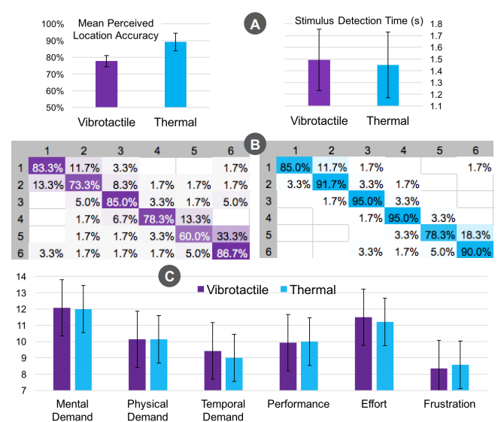
Study 2: Results and discussion
Challenge for vibrotactile
Multiple actuators should be mechanically isolated from the main body
Movement made it hard to recognize the location
Increased demand and effort made accuracy lower.
Hand orientation could have an effect
Notes:
Location accuracy better on thermal but detection was not significantly different

Slide 10
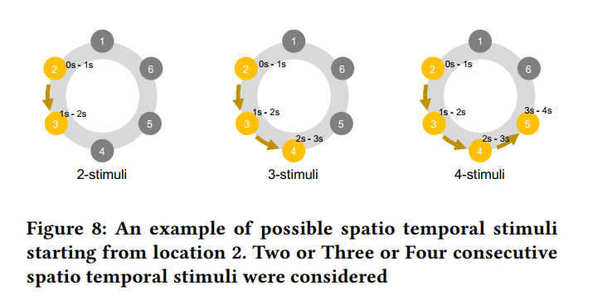
Study 3: Spatio-Temporal feedback with Thermal Wristband
Multiple sequential haptic stimuli to provide haptic notification and alerts
Starting location and number of follow-on stimuli provide “enriched information”
Which app
How many notifications

Slide 11
Study 3: Methods
Same configuration and setup in study 2
Interval between stimuli = 0 seconds
To allow for a continuous moving sensation
Within Subjects (15 participants)
IV: Start location, number of stimuli, modality
DV: perceived starting location, subsequent perceived location
NASA-TLX questionnaire after each condition
Gaming distraction (Online Tetris)

Slide 12
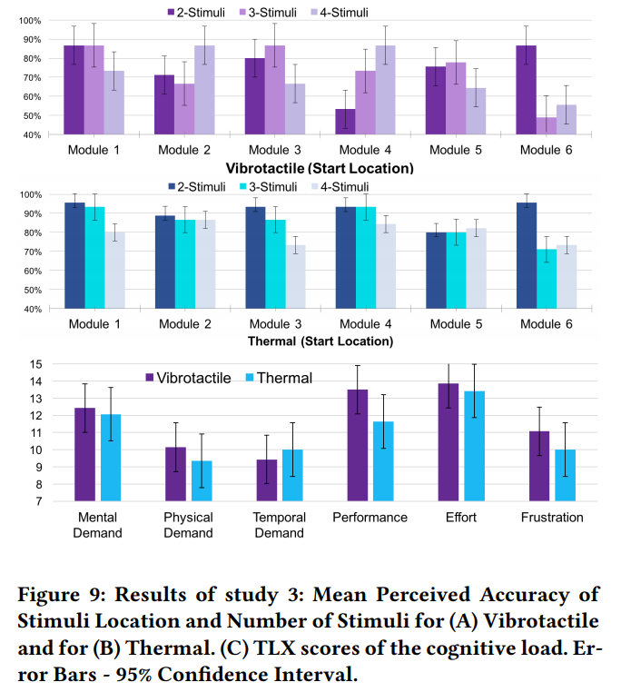
Study 3: Results and discussion
Notes:
Thermal indicated higher accuracy for the perceived stimuli
No significant difference on start location and number of stimuli in both conditions.
Thermal feedback is more accurate in delivering spatial temporal patterns
Perceived location accuracy significantly dropped for vibrotactile
Vibrotactile felt more “discrete”
Thermal = “continuous/analog”

Slide 13
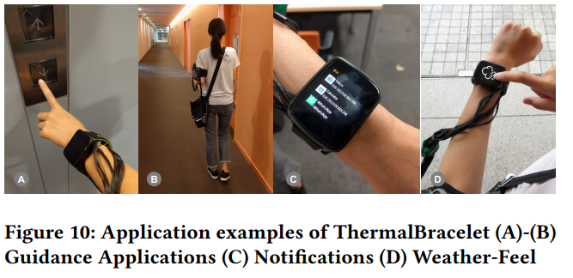
Discussion
Cold thermal & 6 modules worked best
Demonstrated capability of thermal haptic feedback
Overall thermal performed better than vibrotactile feedback
Walking(study 2) accuracy: Thermal (89%) > Vibrotactile (78%)
Application

